Slide 1
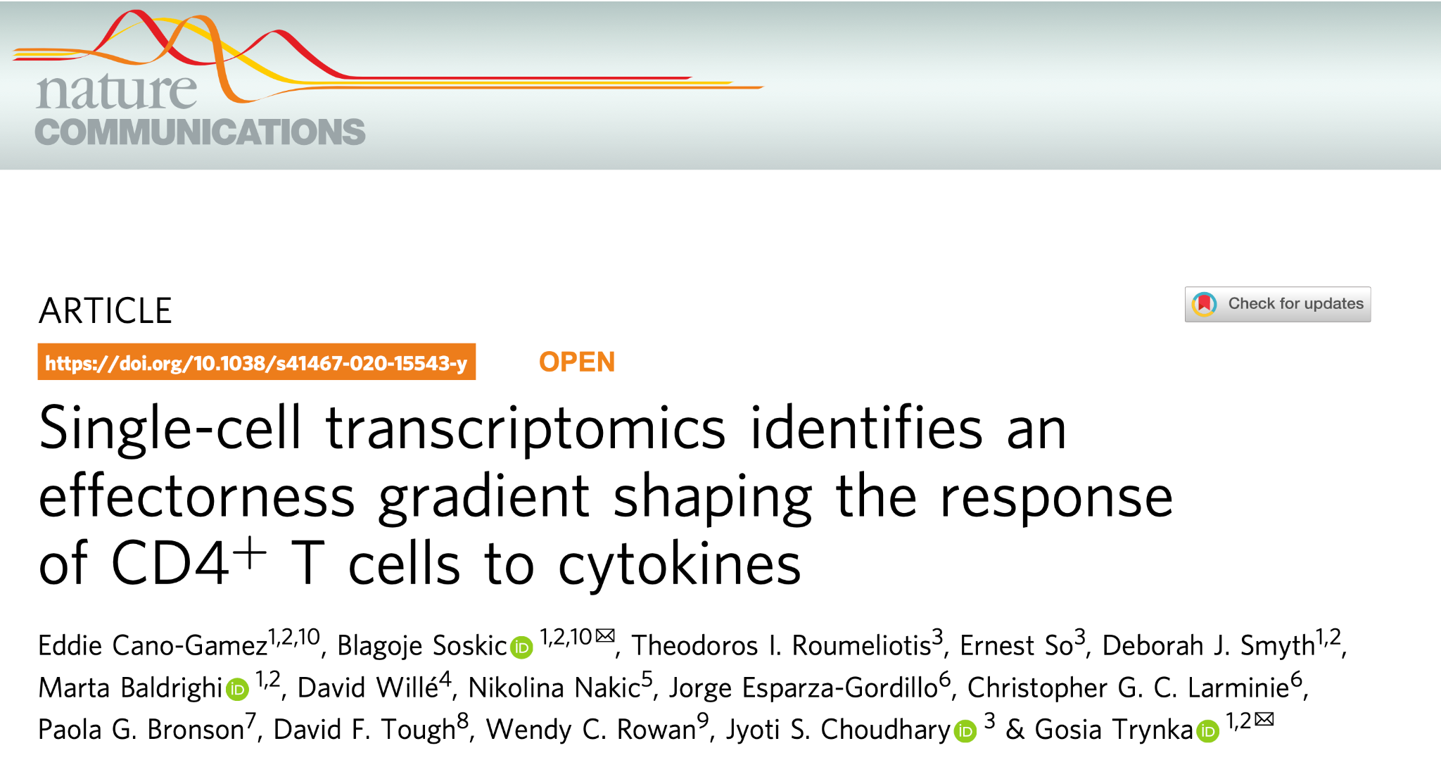

Slide 2
Main question
Characterize effect of cytokines on memory T cells
Previous knowledge:
once polarized, the phenotype acquired by naive CD4+ T cells remains stable
New knowledge:
cytokines can reprogram previously polarized T cells
Notes:
Previous knowledge:
once polarized, the phenotype acquired by CD4+ T cells remains stable
New evidence: cytokines can reprogram previously polarized, cytokines can reprogram previously polarized
Challenge: studying the effects of cytokines on memory T cells is challenging because memory cells comprise multiple subpopulations
characterized the response of naïve and memory CD4 T cells to five different cytokine combinations at two different time points following stimulation, profiling bulk and single-cell gene expression

Slide 3
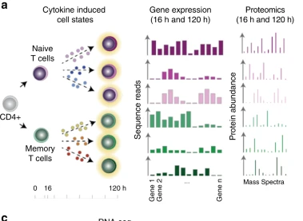
Methods
Main Highlight: while naïve CD4+ T cells are known to change their behavior in response to cytokines, less is known about how memory CD4+ T cells behave in this regard.
They used 40K CD4+ T cells
Communication between immune cells is mediated by cytokines. T cells are like noob army generals that when exposed to certain chemicals becomes specialised and help command other cells to recruit at the site of immune assault. The authors want to record how the see how different Tm generals
central (TCM)
effector (TEM)
effector memory cells re-expressing CD45RA (TEMRA)

Slide 4
Why they used scRNA?
Studying the effects of cytokines on memory T cells is challenging because memory cells comprise multiple subpopulations
Characterize transition between naive T cells to effector subtypes

